Slide 1
Ascension Technology
C.A.R.
Matthew Darby, Maggie Burton, Weston Straw, Mark Du, Andrew Case, Stevie Damrel

Slide 2



Where we are now, Chapter 3: a completed project

Slide 3
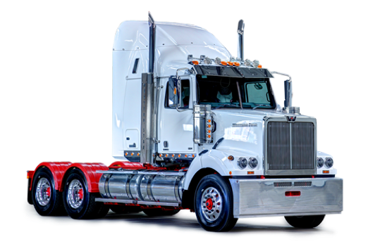
And now for a demo…

Slide 4
Video Demo
https://www.youtube.com/watch?v=TncPhi9kSU4&feature=youtu.be

Slide 5
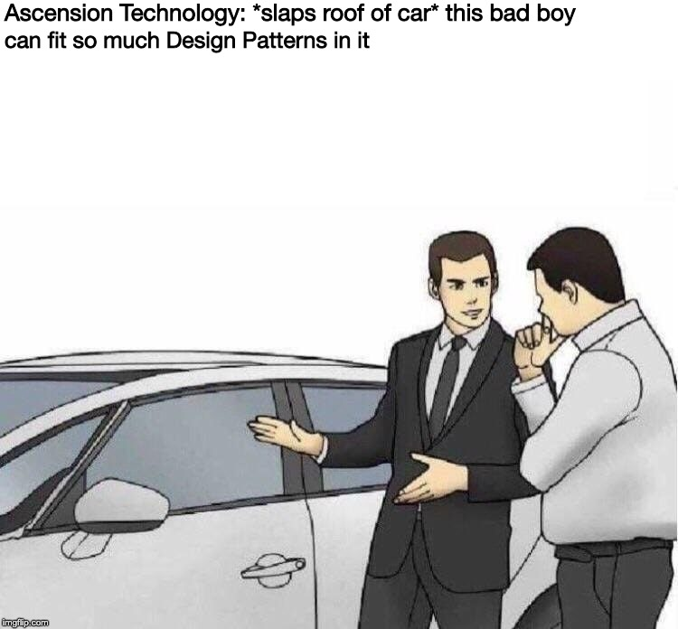
Design Patterns

Slide 6
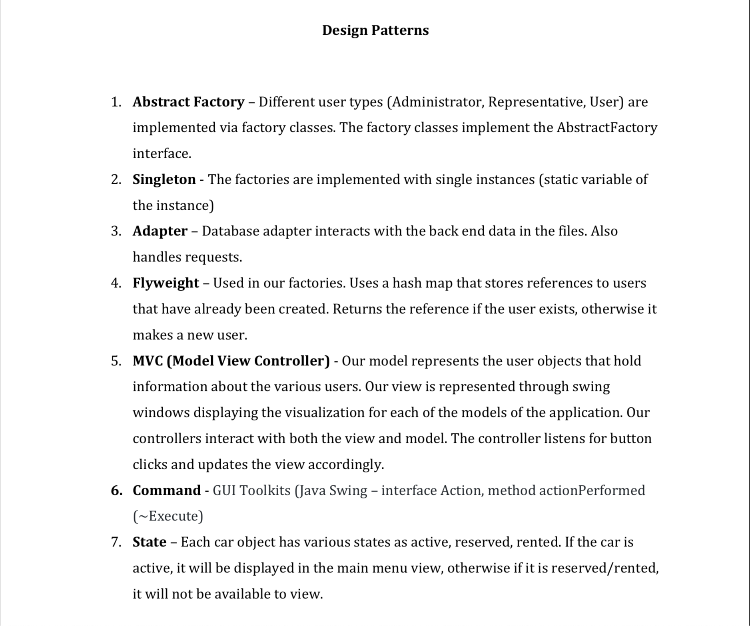

Slide 7
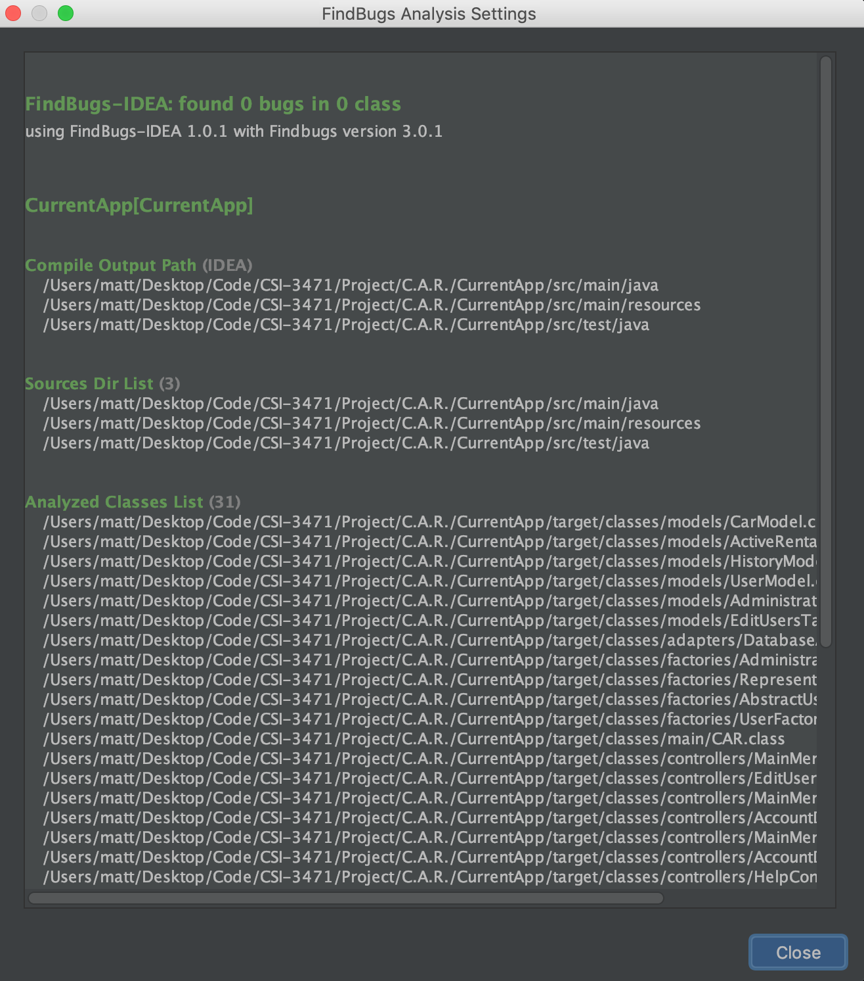


Slide 8
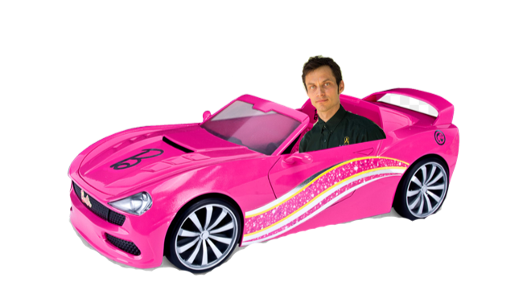
Website
https://baylorsailor.github.io/C.A.R./site

